Slide 1
Loan Distribution Prediction
By: Atharva Thodge

Slide 2
What is Predictive analysis?
The term predictive analytics refers to the use of statistics and modeling techniques to make predictions about future outcomes and performance. Predictive analytics looks at current and historical data patterns to determine if those patterns are likely to emerge again. This allows businesses and investors to adjust where they use their resources to take advantage of possible future events. Predictive analysis can also be used to improve operational efficiencies and reduce risk.

Slide 3
What is loan distribution prediction
This system helps in predicting whether or not a person can get loan or not with a precision.

Slide 4
Random forest Algorithm
Random Forest is a popular machine learning algorithm that belongs to the supervised learning technique. It can be used for both Classification and Regression problems in ML. It is based on the concept of ensemble learning, which is a process of combining multiple classifiers to solve a complex problem and to improve the performance of the model.
As the name suggests, "Random Forest is a classifier that contains a number of decision trees on various subsets of the given dataset and takes the average to improve the predictive accuracy of that dataset." Instead of relying on one decision tree, the random forest takes the prediction from each tree and based on the majority votes of predictions, and it predicts the final output.
The greater number of trees in the forest leads to higher accuracy and prevents the problem of overfitting.

Slide 5
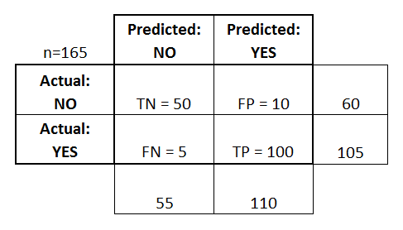
Confusion Matrix

